Slide 1
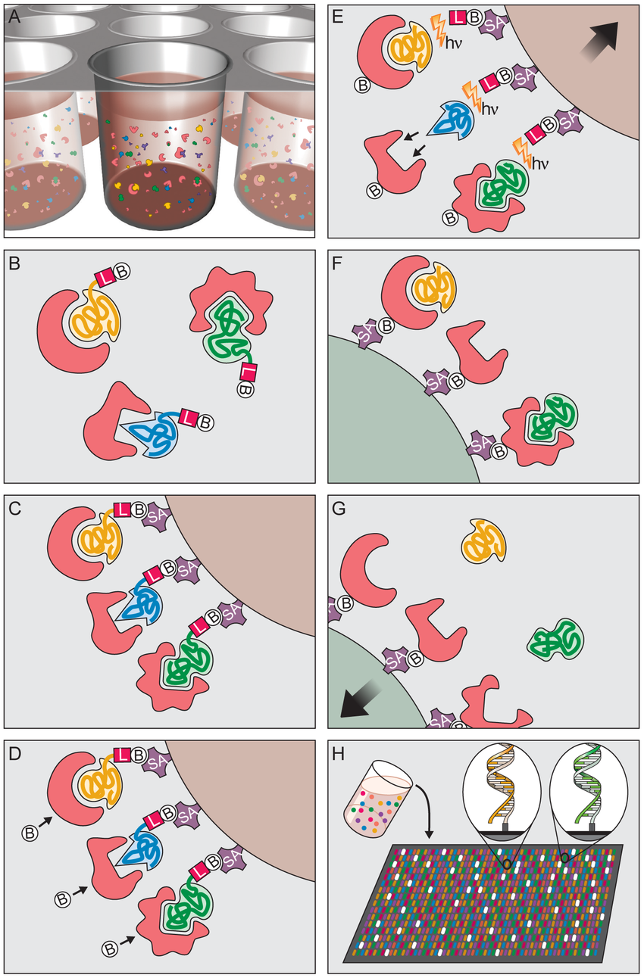
Principle of Multiplex SOMAmer Affinity Assay
Binding. SOMAmers and samples are mixed in 96-well microwell plates and allowed to bind. Cognate and non-cognate SOMAmer-target protein complexes form.
SOMAmer-protein binding: DNA-based SOMAmer molecules (gold, blue, and green) have unique shapes selected to bind to a specific protein. SOMAmers contain biotin (B), a photo-cleavable linker (L) and a fluorescent tag at the 5′ end. Most SOMAmers (gold and green) bind to cognate proteins (red), but some (blue) form non-cognate complexes.
Catch-1. SOMAmers are captured onto a bead coated with streptavidin (SA) which binds biotin. Un-complexed proteins are washed away.
Proteins are tagged with NHS-biotin.
Photocleavage and kinetic challenge. UV light (hν) cleaves the linker and SOMAmers are released from beads, leaving biotin on bead. Samples are challenged with anionic competitor (dextran sulfate). Non-cognate complexes (blue SOMAmer) preferentially dissociate.
Catch-2 SOMAmer-protein complexes are captured onto new avidin coated beads by protein biotin tag. Free SOMAmers are washed away.
SOMAmers are released from complexes into solution at high pH.
Remaining SOMAmers are quantified by hybridization to microarray containing single-stranded DNA probes complementary to SOMAmer DNA sequence, which form a double-stranded helix. Hybridized SOMAmers are detected by fluorescent tags when the array is scanned.

Slide 2
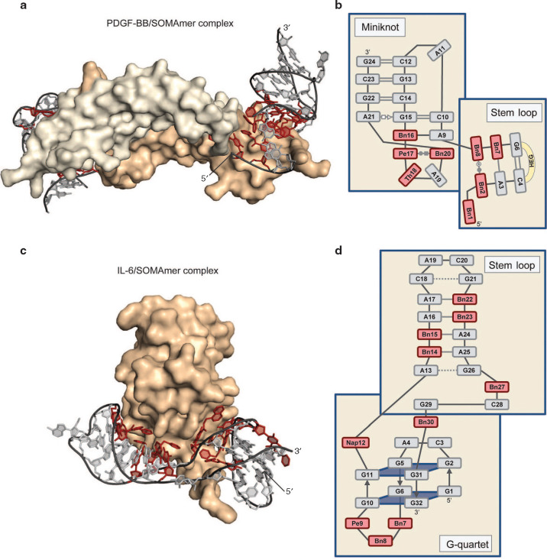

Slide 3
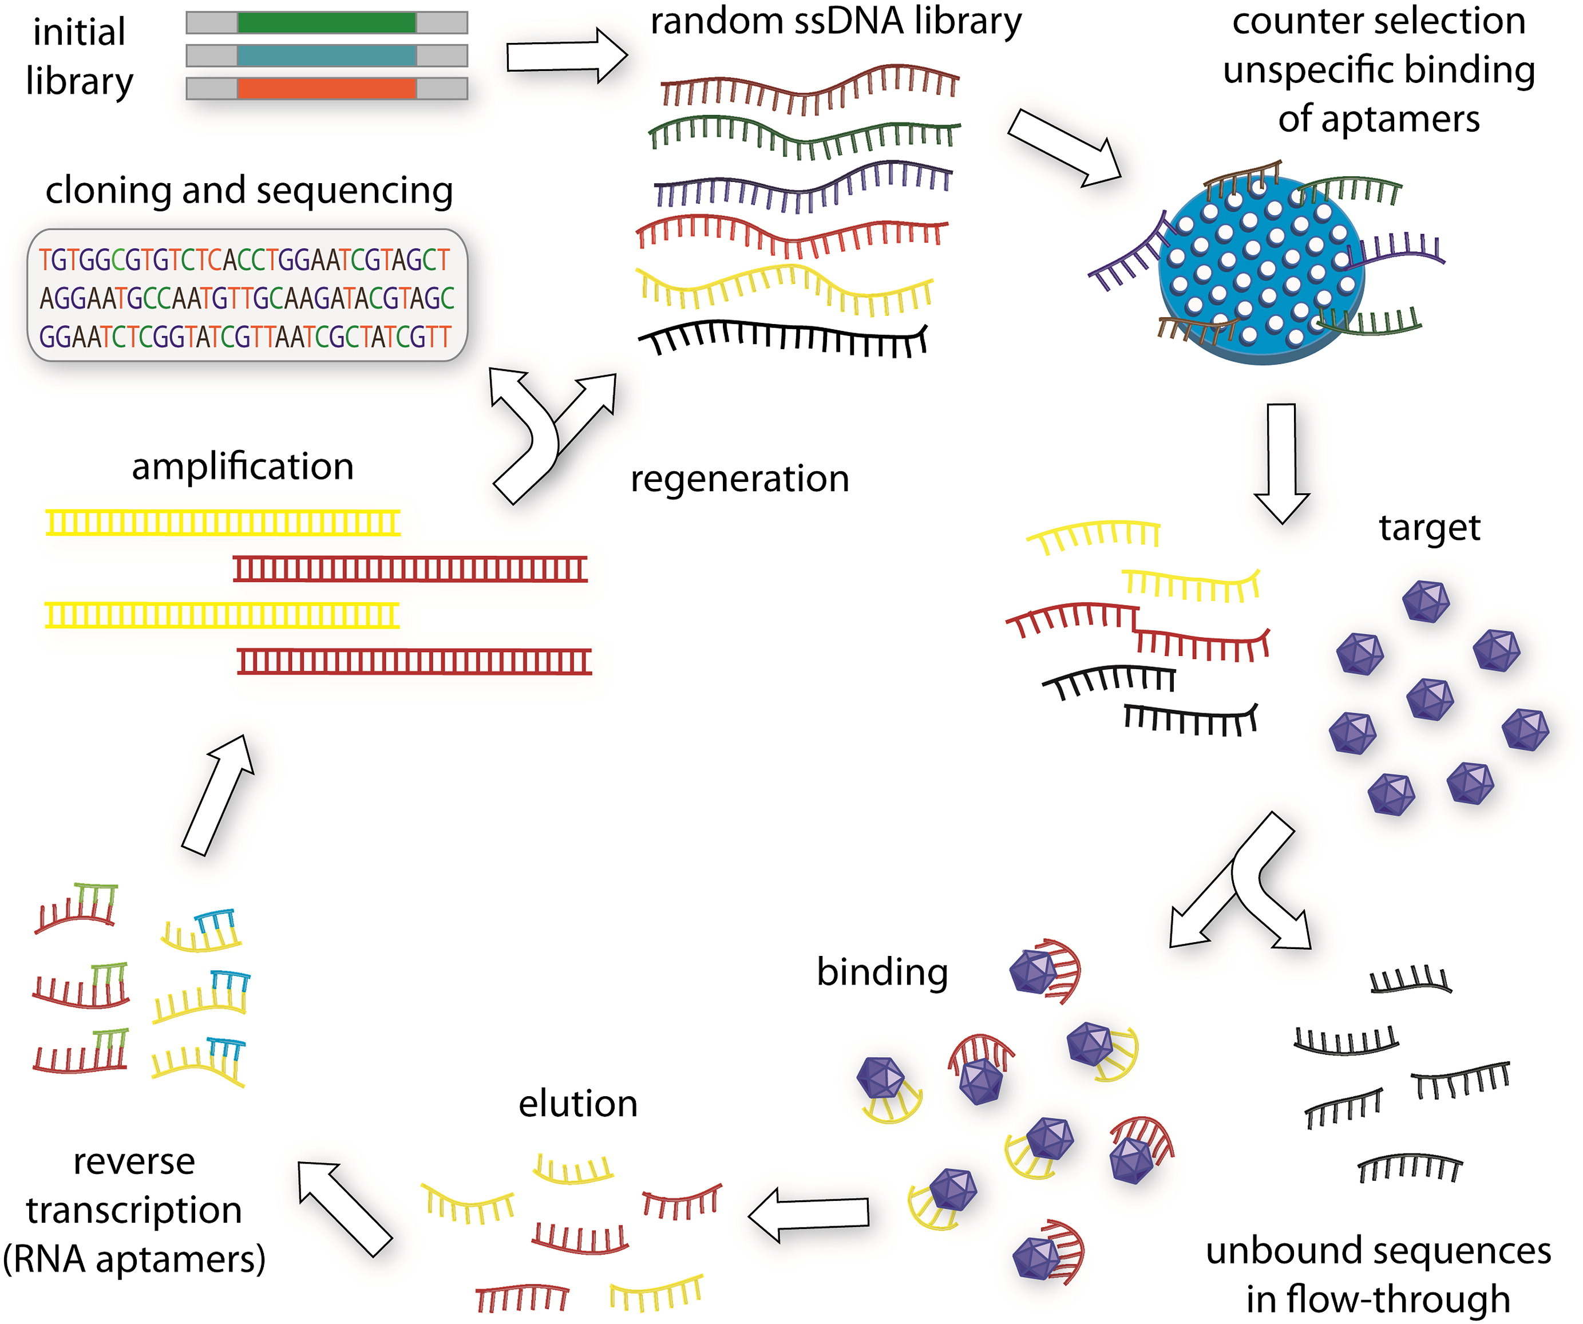
SELEX for Aptamer Selection
https://doi.org/10.1016/j.biotechadv.2015.02.008

Slide 4
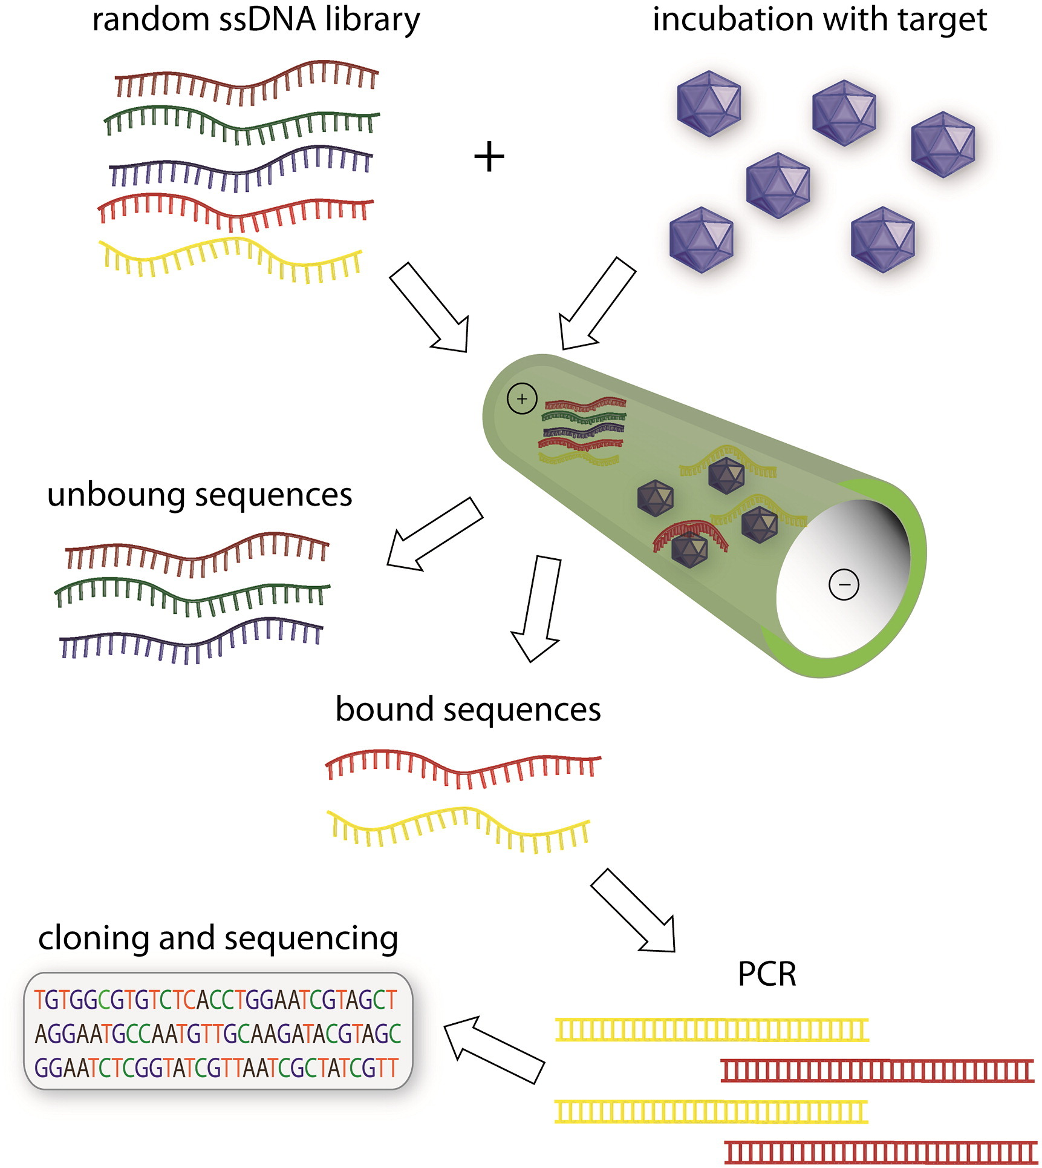
SELEX Using Capillary Electrophoresis
https://doi.org/10.1016/j.biotechadv.2015.02.008

Slide 5
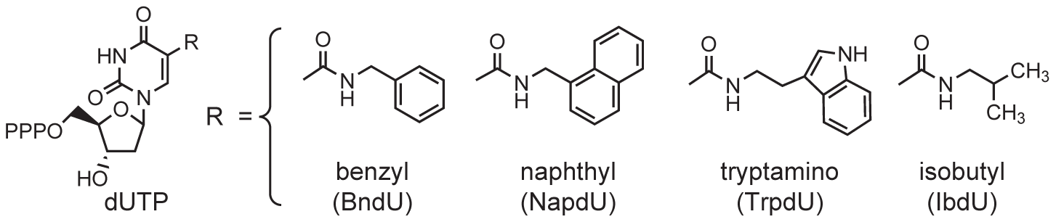
Somologic SOMAmer – Slow Off-rate Modified Aptamers
Notes:
Deoxy uridine triphosphate

Slide 6
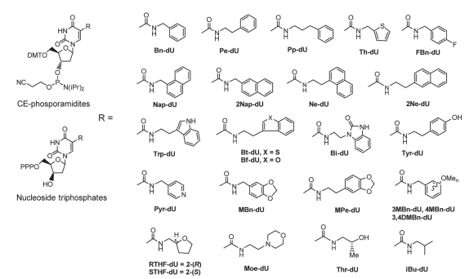
Nucleic Acid Ligands with Protein-Like Side Chains

Slide 7
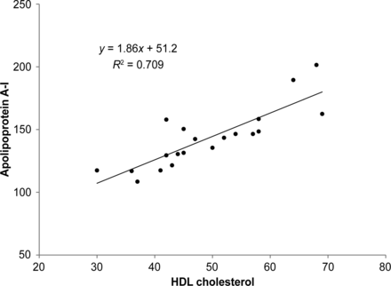
Ngo et al. Aptamer-Based Proteomic Profiling Reveals Novel Candidate Biomarkers and Pathways in Cardiovascular Disease Circulation 2016
Measured 1129 proteins using Somoscan technology in plasma
UW Assays
Somologic ApoA1 assay doesn’t correlate with HDL
retinol-binding protein 4 was not associated with diabetes

Slide 8
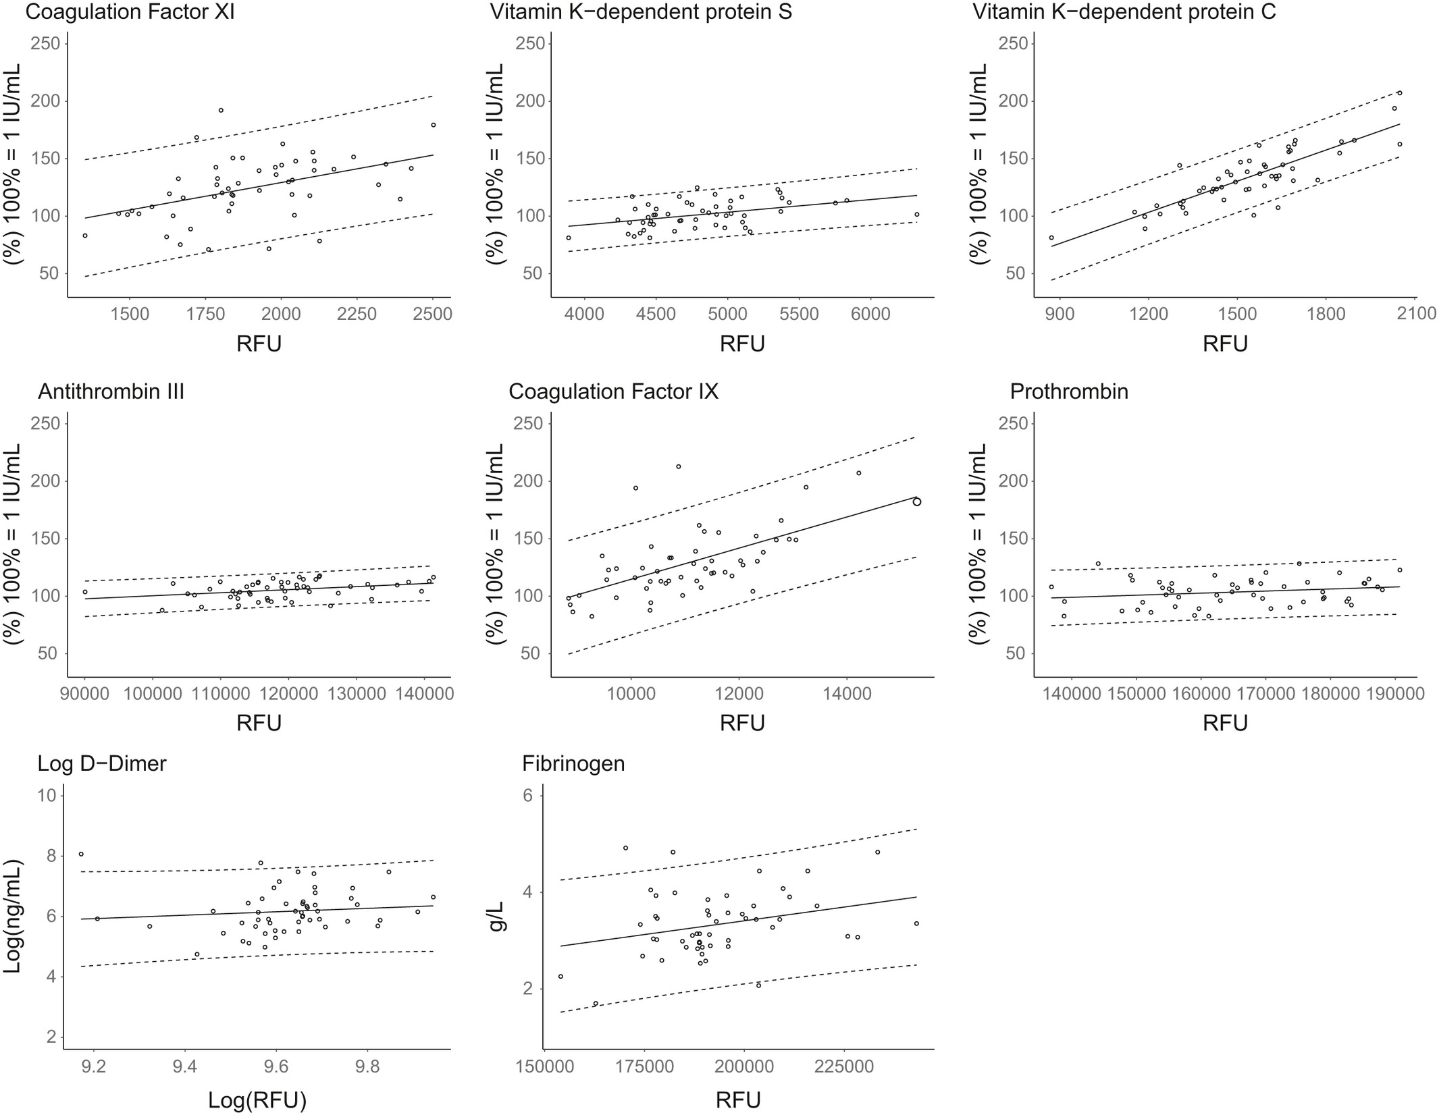
Faquil et al. Agreement of aptamer proteomics with standard methods for measuring venous thrombosis biomarkers
Measured proteins using Somoscan technology in plasma
626 Patients
Common venous thrombosis biomarkers measured using laboratory tests
“SomaScan platform is not interchangeable with validated laboratory instruments for the VTE markers in our study. Therefore, caution is needed when applying SomaScan measurements for hypothesis-driven VTE studies using these markers.”

Slide 9
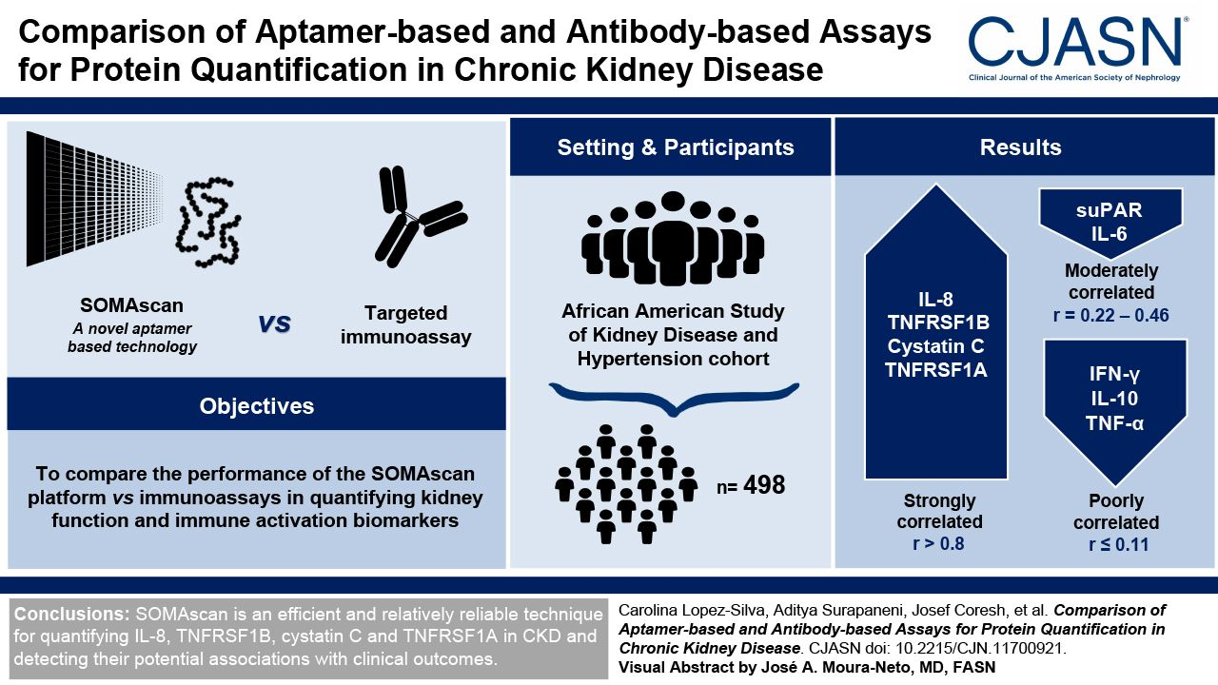
Lopez-Silva et al. Comparison of Aptamer-Based and Antibody-Based Assays for Protein Quantification in Chronic Kidney Disease
Measured 7000 proteins using Somoscan technology in plasma
498 Patients
Gold Standard Assays Performed
Six biomarkers (IL-8, soluble TNF receptor superfamily member 1B [TNFRSF1B], cystatin C, soluble TNF receptor superfamily member 1A [TNFRSF1A], IL-6, and soluble urokinase-type plasminogen activator receptor [suPAR]) had non-negligible correlations (r=0.94, 0.93, 0.89, 0.85, 0.46, and 0.23, respectively) between SOMAscan and immunoassay measurements, and three (IL-10, IFN-γ, and TNF-α) were uncorrelated (r=0.08, 0.07, and 0.02, respectively). Of the six biomarkers with non-negligible correlations, TNFRSF1B, cystatin C, TNFRSF1A, and suPAR were negatively correlated with measured GFR and associated with higher risk of kidney failure. IL-8, TNFRSF1B, cystatin C, TNFRSF1A, and suPAR were associated with a higher risk of mortality via both methods. On average, immunoassay measurements were more strongly associated with adverse outcomes than their SOMAscan counterparts.

Slide 10
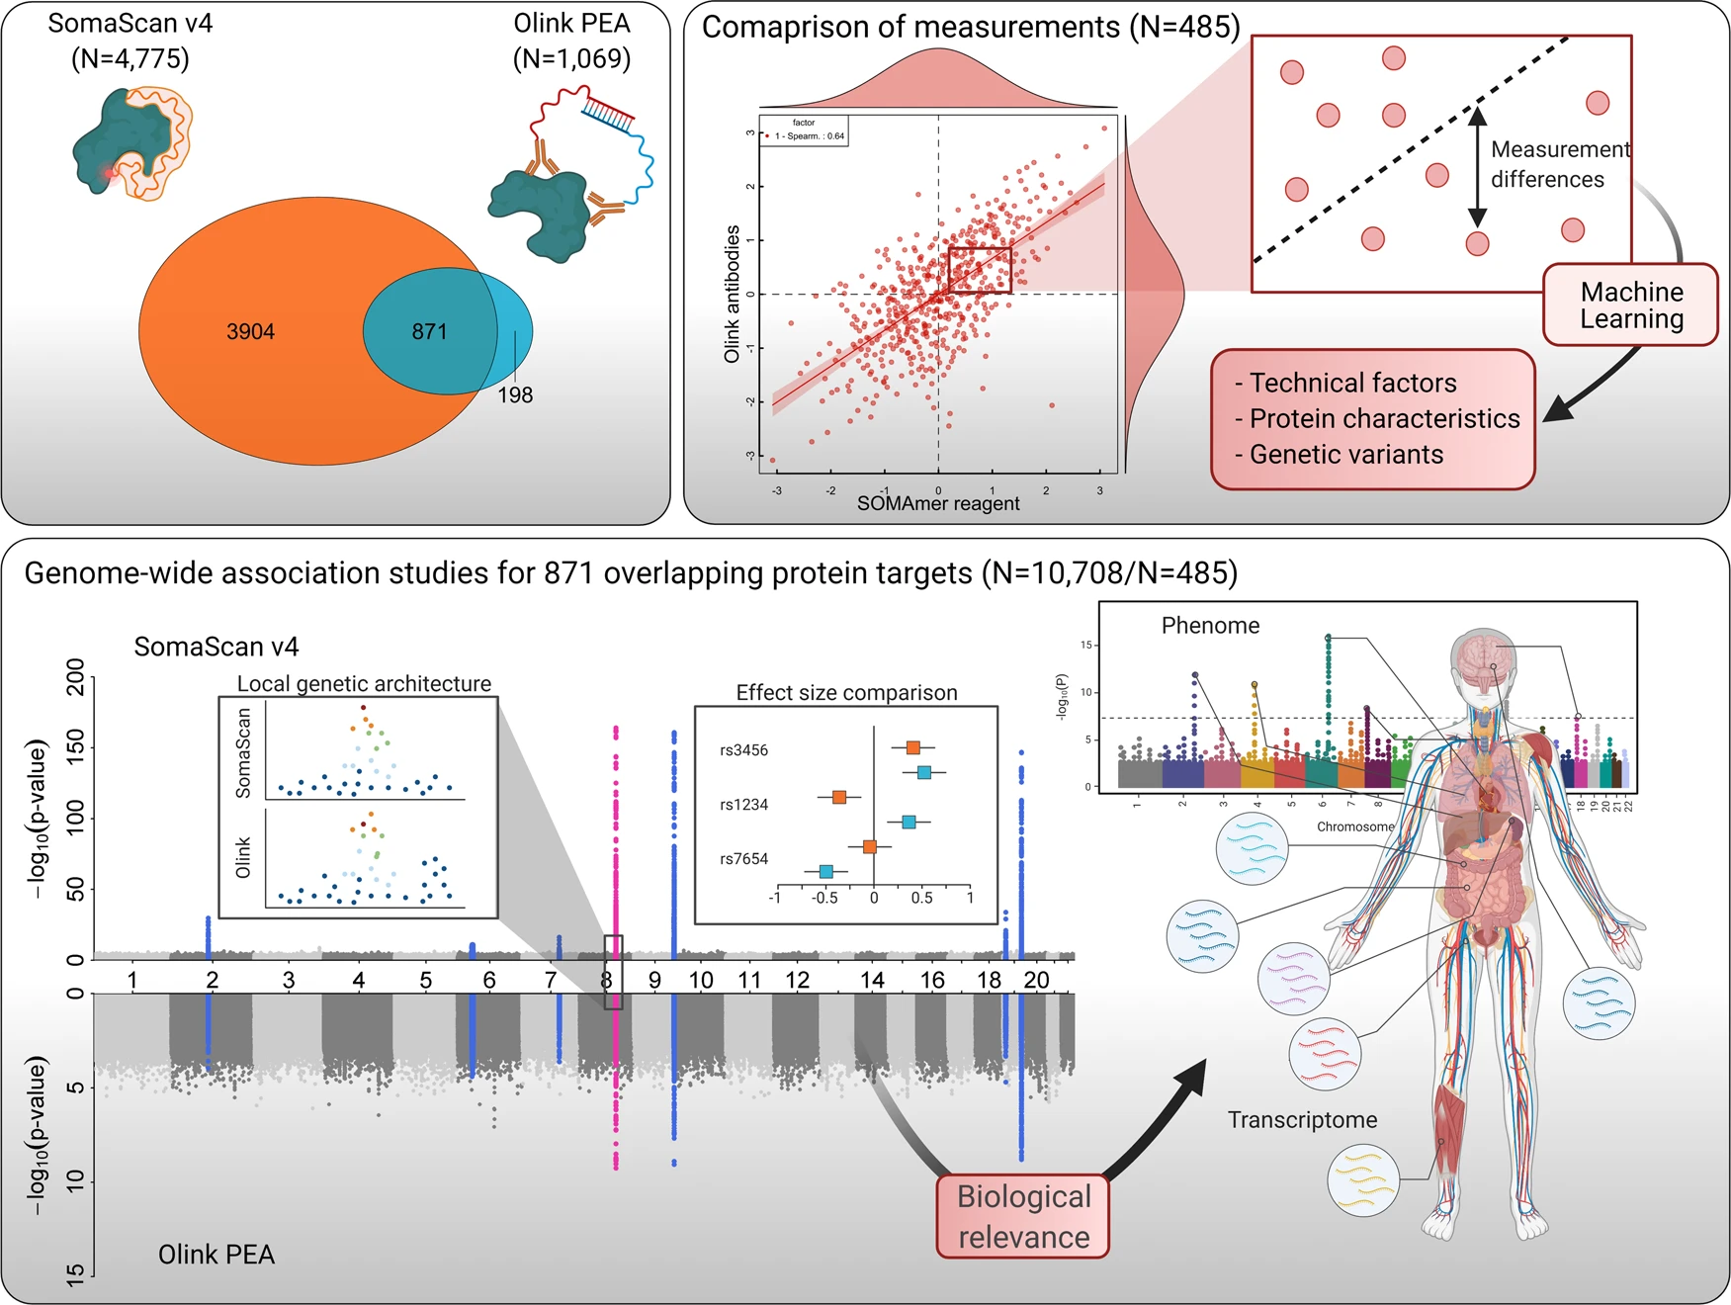
Pietzner et al. Synergistic insights into human health from aptamer- and antibody-based proteomic profiling
Only 1/3 of the measurements are corroborated with O-link.
“A common pattern among results not shared between both assays related to the reliance of the SomaScan assay to a conserved protein structure to enable aptamer binding”
“the lack of full technical details of the assays that are not in the public domain as they are commercially sensitive and general methodological differences between the assays did not permit a more rigorous assessment of non-biological factors. This includes the similarity of synthetic peptides used to select binding reagents or a measure of binding affinity for antibodies, which might likely yield additional insights into possible differences.”

Slide 11
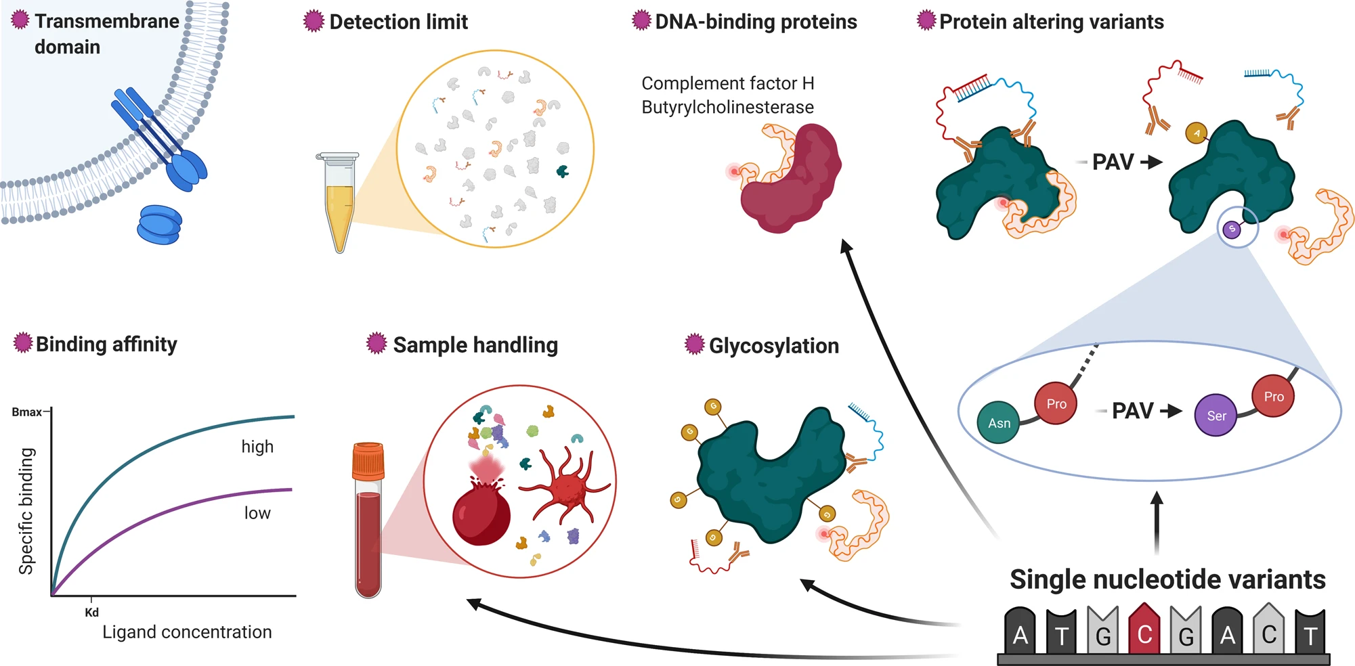

Slide 12
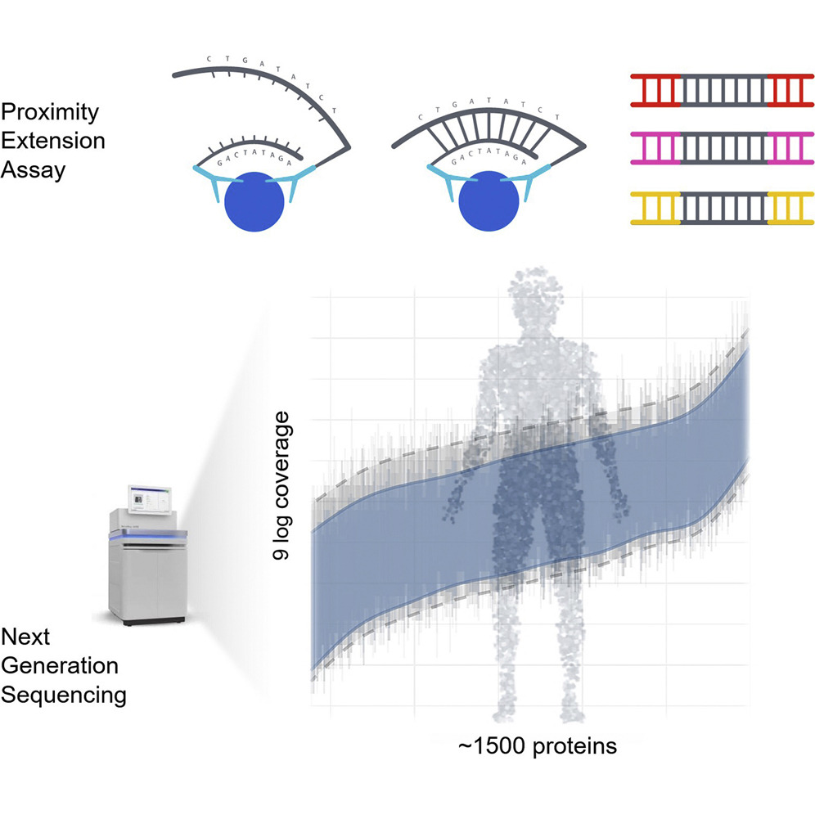
Olink is a Proximity Extension Sandwich Assay

Slide 13
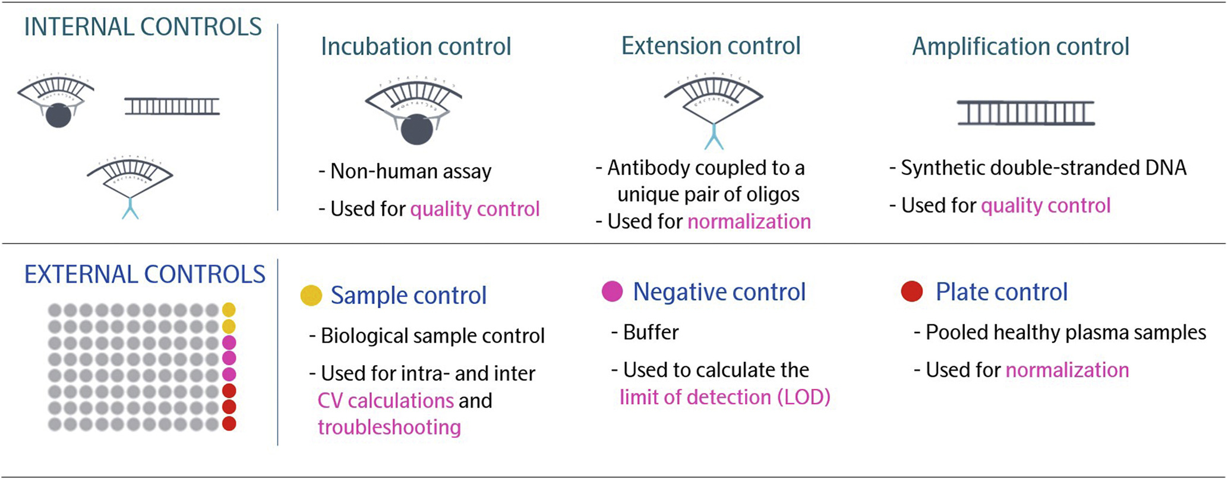

Slide 14
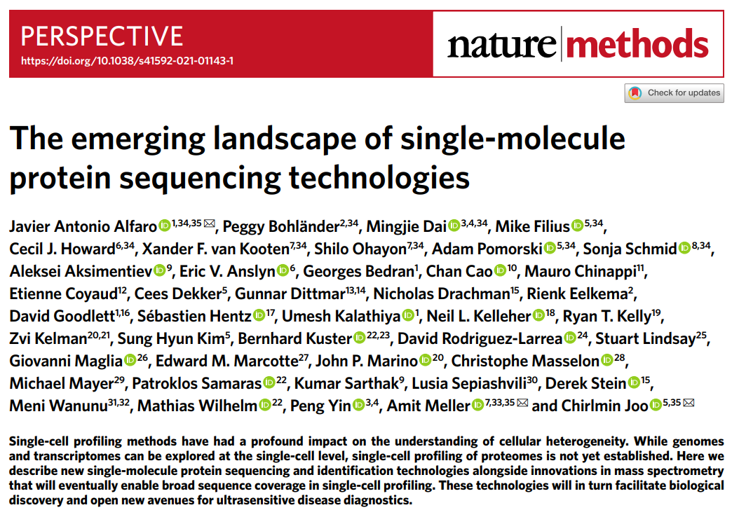
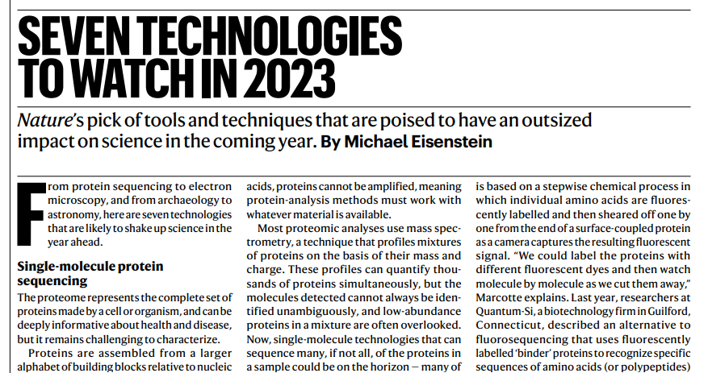
The Elephant in the room: Is LC-MS the future of proteomics?

Slide 15
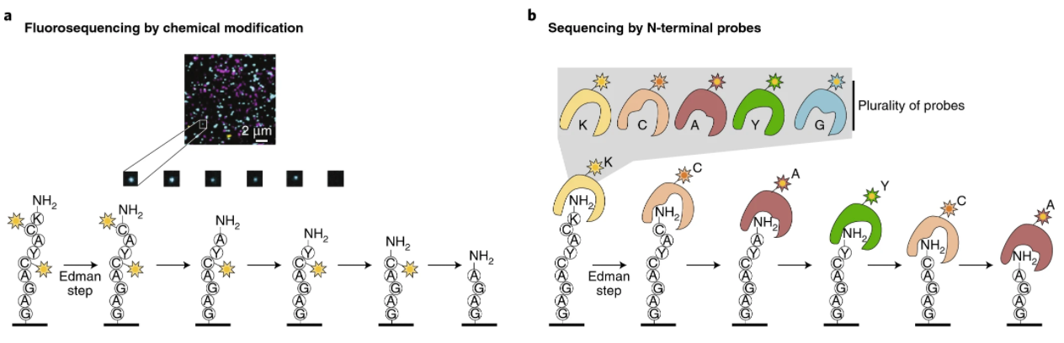
Most Single Molecule Methods are Based on Edman Degradation
Each cycle of Edman degradation is about 1 – 1.5 hours!!

Slide 16
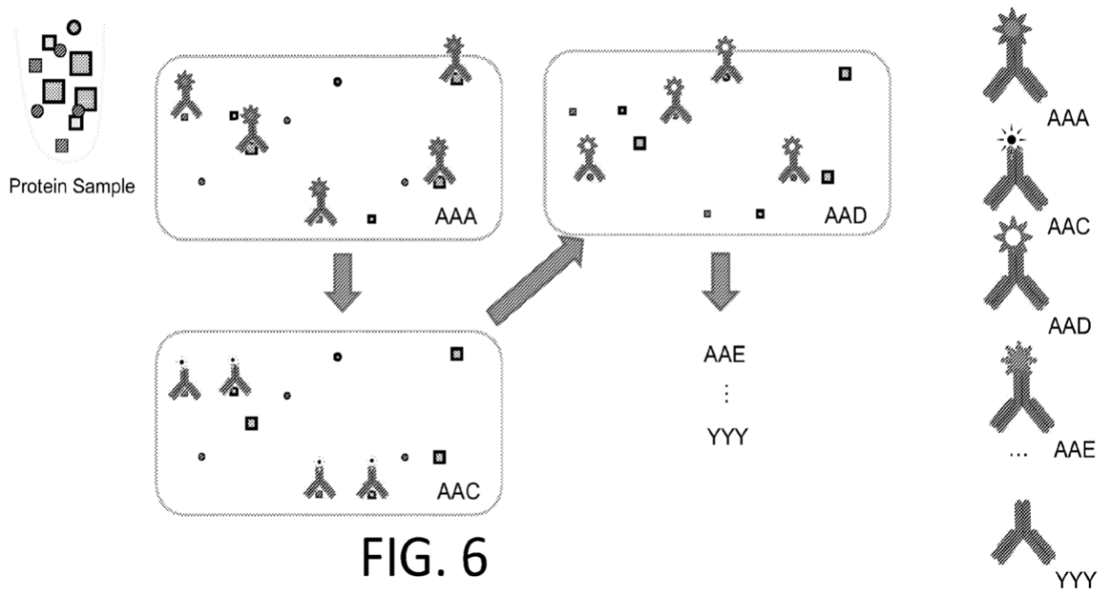
Anti-Peptide Antibody Decoding -- Nautilus

Slide 17
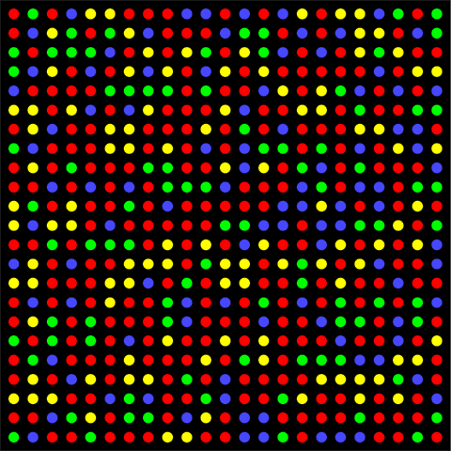
How much better do proteomics methods need to be?
Proteomics is Hard:
400,000 mRNA molecules per cell = 40 million reads
10,000,000,000 protein molecules per cell = 1 trillion reads
Fluorescent wavelength = 200 – 750 nm
Leads to a practical density of ~1 µm
1 million reads: 1 mm²
100 million reads: 1 cm²
10 billion reads: 10 cm²
1 trillion reads: 1 m²
Possible to scale 10x more than Illumina
However, 25,000x is going to require a different approach

Slide 18
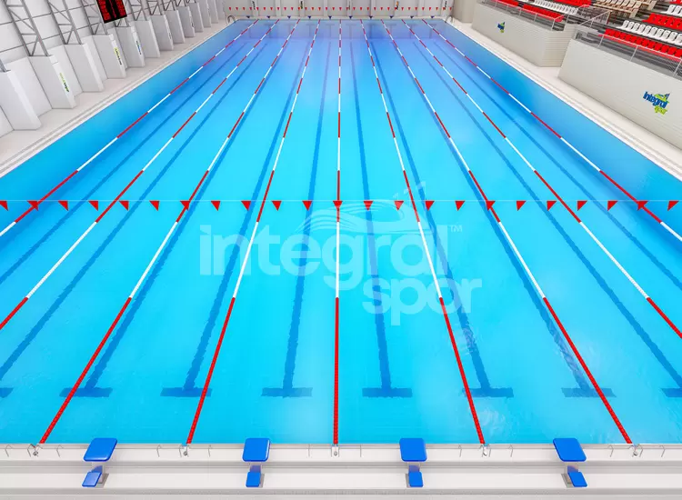
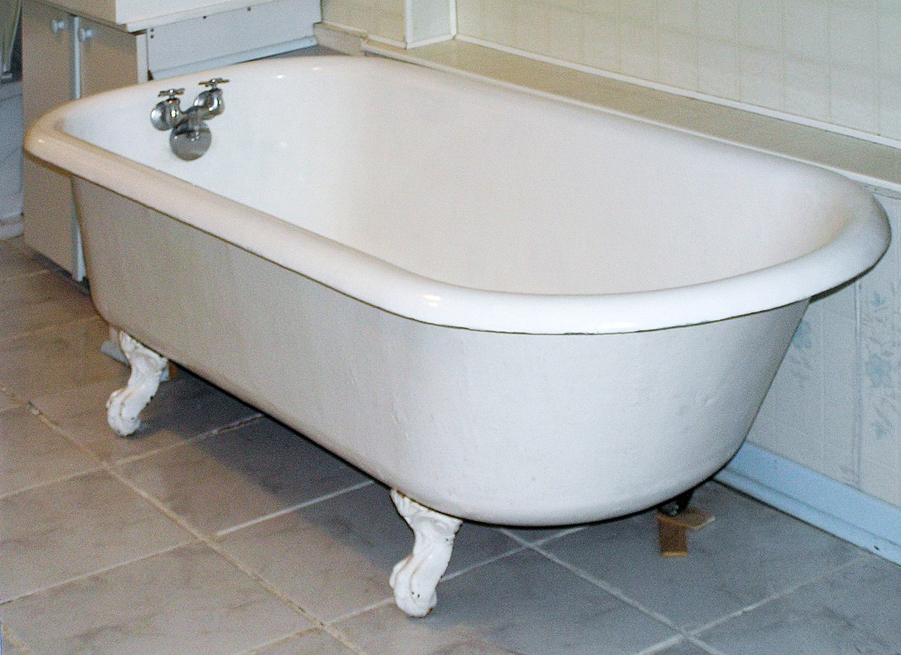
Measuring the volume of a swimming pool
2.5 million liters (proteome)
80-100 liters (transcriptome)

Slide 19
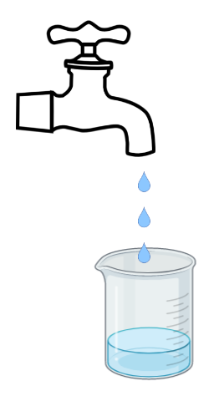
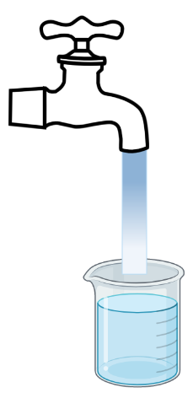
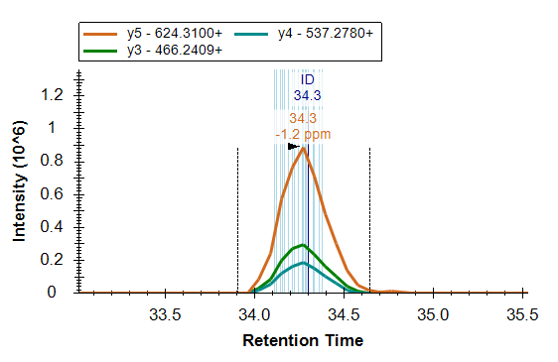
Instead of Counting in Space – Count in Time
Average Transcript is present in ~5-10 copies per cell
Average Protein is present in 10⁴-10⁵ copies per cell
A
A
A
X 10⁵
A
A
A
A
A
A
A
A
A
A
A
A
A
A
A
A
A
A
A
A
A
A
A
A
A
A
A
Time

Slide 20
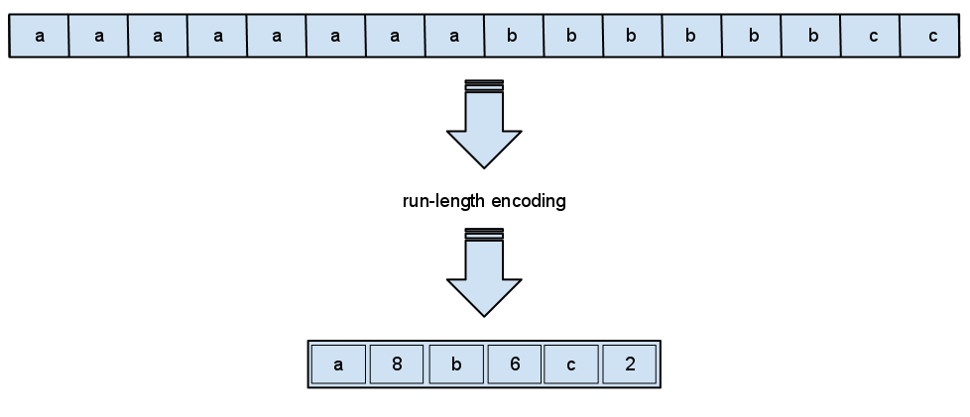
LC-MS/MS is a Lossless Single Molecule Compression Method
Single Molecule Counting
LC-MS/MS
A
A
A
A
A
A
A
A
A
A
A
A
A
A
A
A
A
A
x8
A
A
A
A
A
A
A
A
A
A
A
A
A
A
A
A
A
A
A
A
A
A
A
A
A
A
A

Slide 21
Do we really want to count one ion/one molecule at a time?
LC-MS and GC-MS have used pulse counting detectors in the past
Largely disappeared in favor of ion current measurements
Do we care if we measure 1 ion every nanosecond or 10⁶ ions every millisecond?
If we need to measure 1000x more ions
a single ion method will then need to measure 1 ion every picosecond.
an ion current method will measure 10⁶ ions every microsecond or 10⁹ ions every millisec

Slide 22
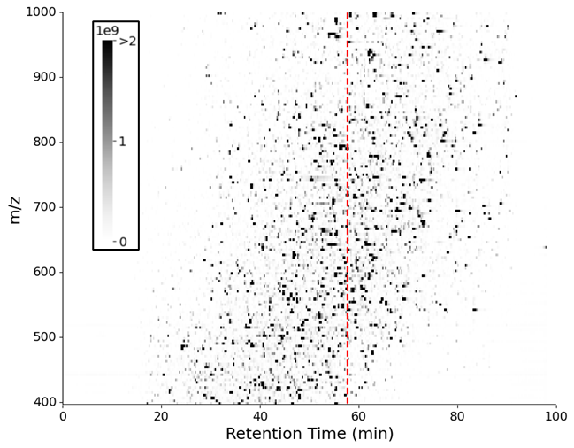
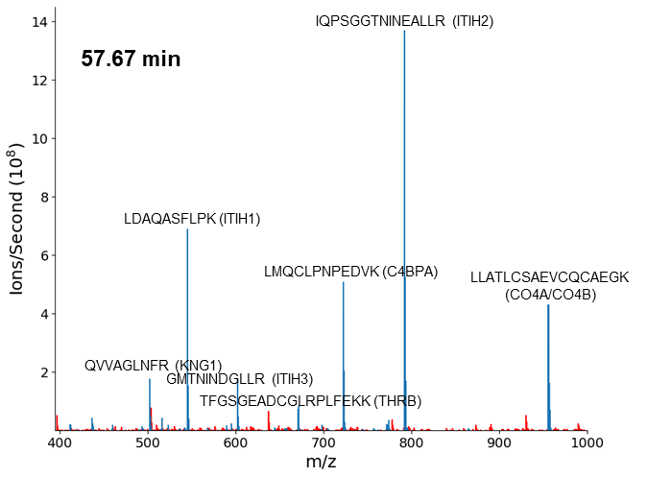
Aggregating peptides and counting in bulk

Slide 23
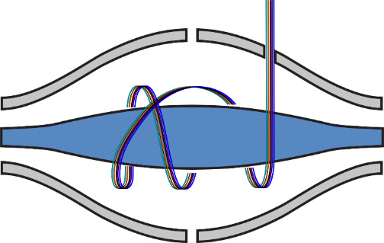
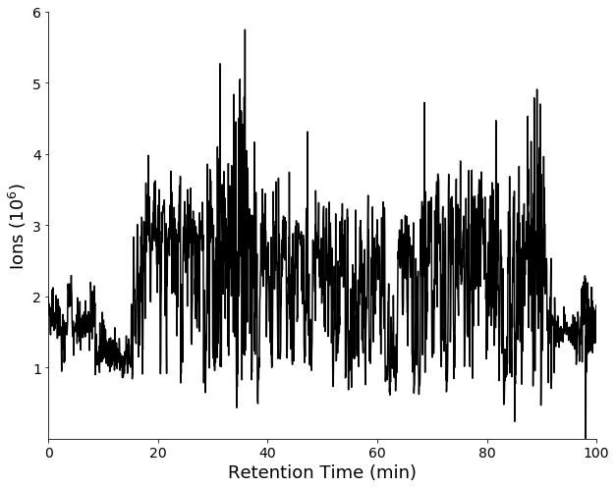
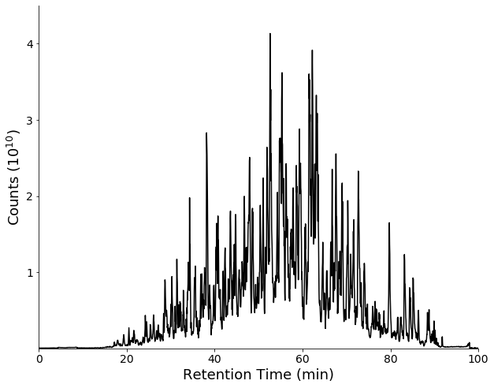
Instead of Counting in Space – Count in Time
We Can Count:
>500,000 ions in 30-60 msec
30 million ions/min
1.8 billion ions/hour
<$100 per hour
Normalize per time.
Counts (ions/sec)
Analogous to RPKM or TPM normalization
Total # of ions: 5,057,320,876
Total TIC: 10,523,443,416,667

Slide 24
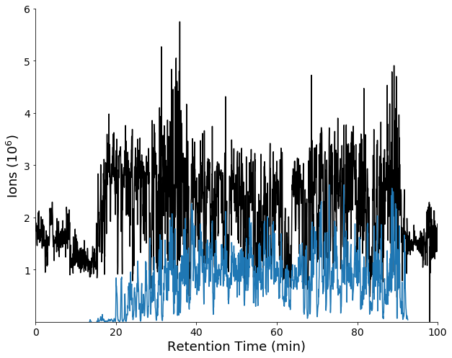
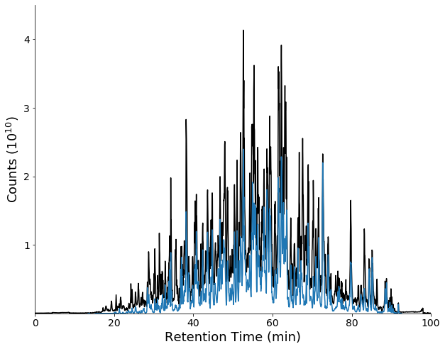
Instead of Counting in Space – Count in Time
We Can Count:
>500,000 ions in 30-60 msec
30 million ions/min
1.8 billion ions/hour
<$100 per hour
Normalize per time.
Counts (ions/sec)
Analogous to RPKM or TPM normalization
Total # of ions: 5,057,320,876
Ions mapped to peptides: 1,222,192,892
24.2% of the ions
Total TIC: 10,523,443,416,667
TIC Mapped: 4,883,887,856,314
46.4% of the signal
LC-MS is More Efficient at Counting Peptides than Illumina is at Counting Nucleotides

Slide 25
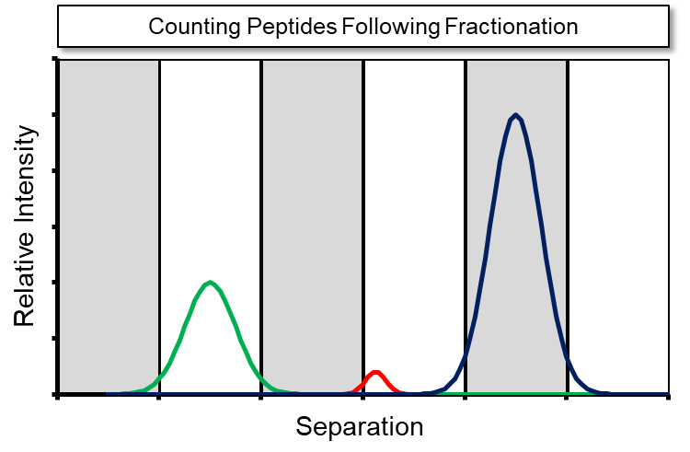
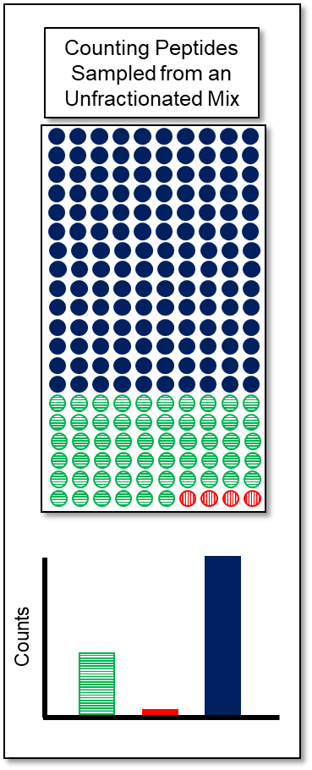
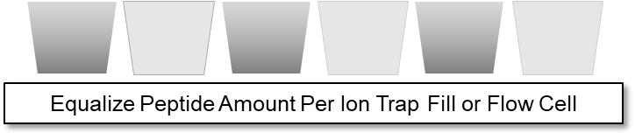
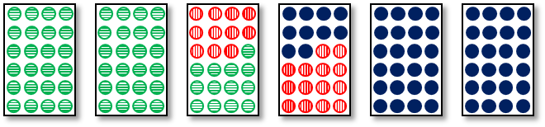
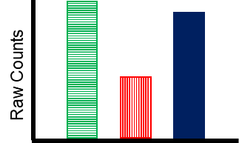
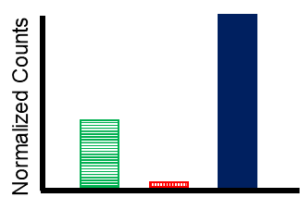
It better to group by each molecule type and count in aggregate
RAW Counts and Normalized Counts based on Peptide Load

Slide 26
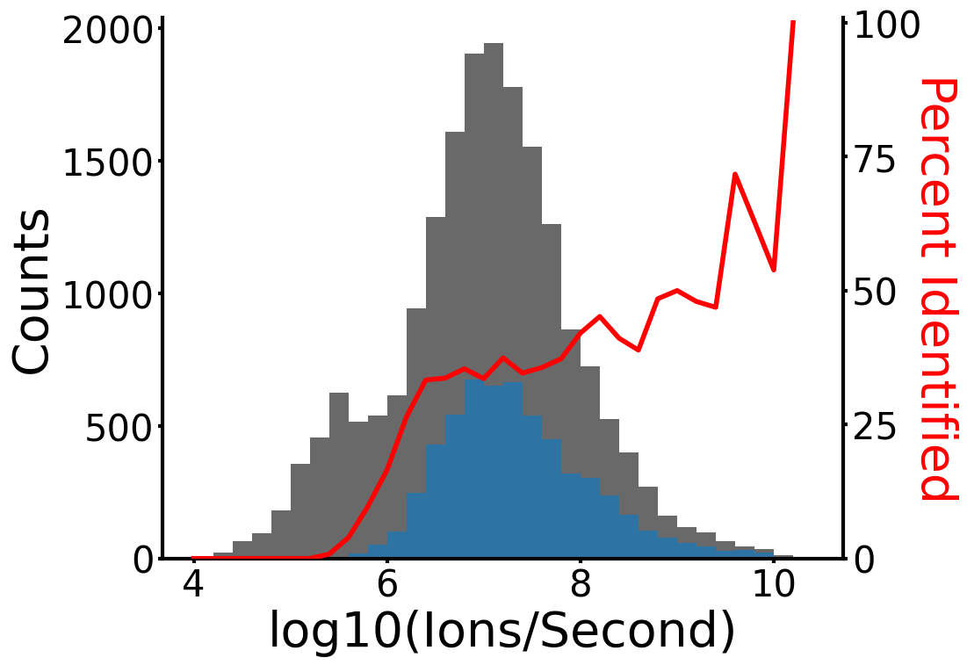
Lots of room for improvement!

